Slide 1
Computer & Internet Safety
YOU, ME & EVERYONE ELSE
Notes:
Welcome, and thank you for downloading the computer and Internet safety guide. The goal of this guide is to help educate and make kids more aware of some of the risks that exist on the Internet and with improper technology use. The Internet and the technology we use are wonderful and provide all of us with so much value in our lives. Unfortunately, the Internet and technology can also be used in a way that it was not intended. Therefore, it is important to educate our youth and make them more aware. As you read through this guide in preparation for the presentation, you will learn more about using computers and technology in a manner that is safe to help protect you and our youth.
This presentation is a consensus project, designed by the community, for the community. It is supported by SANS Securing The Human. We welcome and encourage any feedback on how to improve this presentation. All feedback should be sent to <community@securingthehuman.org>. For more information about SANS Securing The Human or other security awareness resources, including the latest version of this presentation, please visit http://cyberaware.securingthehuman.org.

Slide 2

SAFETY GUIDE
Digital world devices
Internet & computer safety
Strangers, friends & you
Helpful safety resources
Notes:
Let’s take a look at what this guide has to offer. As you move through this guide, you will learn more about computing devices that can be used on the Internet, some safety measures to be aware of, threats on the Internet and some helpful resources that you can use to better support kids. Our goal is to enable kids to make the most of the Internet and technology while being able to use it more securely and safely.

Slide 3






COMPUTING DEVICES
Notes:
Computing devices come in all shapes and sizes. In fact, many of today’s devices are getting much smaller and are quite possibly within arm’s reach of us at any given time. That means it is very likely we have instant access to technology and the Internet at a moment’s notice if we need it. These computing devices include smartphones, laptop computers, gaming consoles, e-readers and tablet computers, just to name a few. This means kids can be connected anytime, anywhere. In almost every case, these technologies enable kids to not only communicate with friends, but meet and communicate with strangers, too.

Slide 4

WHO LIKES TO USE COMPUTERS?
Notes:
Before moving forward, now is a good time to find out who likes to use computers and what they like to use them for. This will help give you insight into the various ways technology is being used by the kids and helps to engage them in the presentation. Technology helps us in so many wonderful ways, and many people rely heavily on that technology to do everyday things. Let’s take a look at some examples. Chances are you will find that many of them match what the kids just answered in how they like to use them. This would be a good time to call attention to the students’ answers as they mention where they use technology and why.

Slide 5
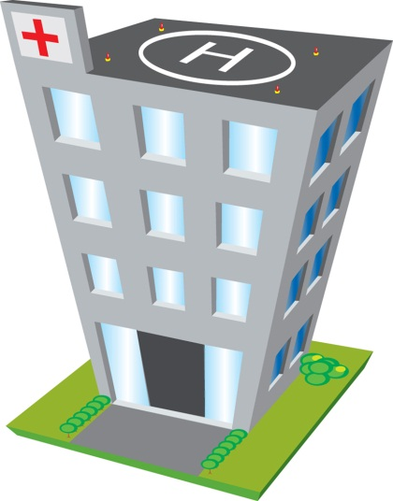
WHERE ARE COMPUTERS?
Notes:
Where are computers and mobile devices? Well, they are almost everywhere! They can be found in schools, libraries, office buildings, hospitals, stores, homes; the list goes on and on. That’s one of the great things about computers and technology -- they are in so many places to help us throughout our day. We’ve become very reliant on them and they provide a lot of value to so many people. It’s great to allow the kids to brainstorm and think about all the locations technology exists so that they can see technology is around them nearly everywhere they go. For instance, many appliances and automobiles are technology and Internet-equipped.

Slide 6


WHAT IS THE INTERNET?
Notes:
Since the term Internet is so widely used, it’s a good idea to ensure that the kids know what the definition of Internet is. Take a moment to discuss with them how it works. The Internet is a very large network of billions of computers all across the world. It is the network that allows everyone with a computing device to gain access to information that we are looking to use. The Internet allows us to communicate with people we know or even people we’ve never met. Let the kids know that without the Internet, they would not be able to visit their favorite website, watch a video clip posted by a friend, download music, send an email or get instant access to information that may have taken hours or days 20 years ago. The Internet has only been available for people like you and me since the early 1990s. It has radically changed the way we communicate and access information in just a short period of time, which is both good and bad.

Slide 7


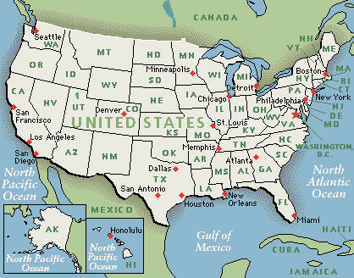
WHAT CAN YOU DO ON THE INTERNET?
Notes:
Now is a good time to engage the kids in what they think the Internet can be used for, giving them a few examples to stimulate thinking. The Internet can help us do our homework, send email, read the news, play games, get directions, listen to music – you name it! In fact, the Internet has made it possible for many people to start their own company and make money, possibly from their home. Also, it does not take long for something on the Internet, like a video, picture or news story to “go viral.” This means it becomes very popular and the entire world might be looking to read or see the story. The buzz can spread quickly and in just a few minutes.

Slide 8
INTERNET SAFETY
Do any of you have special Internet safety rules?
Notes:
As you can see, the Internet is wonderful and can provide a lot of value in our lives. Computing devices allow us to connect to the Internet and share in this global network of information. However, while the Internet is very valuable and generally used for good, it can also be misused by “bad guys.” Since there are people looking to do harm on the Internet, it is important to stress to the kids that they learn to be aware of these threats and how to protect themselves. This would be a good time to ask the kids if they have any special Internet safety rules they live by. For instance, you may find that they’ve learned not to share their passwords. Ask them what rules they have and why.

Slide 9
3 BASIC THREATS
STRANGERS
FRIENDS
YOURSELF
Notes:
Here are some examples of three basic threats on the Internet. 1) Strangers – people we don’t know and may not be able to see face-to-face. 2) Friends – yes, believe it or not, friends and classmates can be a threat on the Internet. 3) Yourself – yes, you! (In this case, the kids.) Kids may do things on the Internet that put them at risk. The objective here is not to strike fear into the kids or make them think that using the Internet is bad. Rather, the goal is to point out some examples of threats and help them become more aware. Let’s discuss in more detail each of these threats.

Slide 10
STRANGERS ONLINE
Notes:
First, strangers online. It’s important to know that there are billions of other people using the same Internet that we are! Yes, that’s A LOT of people! It’s important to note that people online are able to fake whom they claim to be. They can even pretend to be a child, when in reality they are a grown up. So while the person connecting to you may refer to themselves as someone whom you might know, the kids may not be able to tell the difference and it could be a stranger they don’t know. It’s likely that many kids are not aware of the vast amount of Internet users and the potential risks. They’re probably just focused on playing a game and don’t realize there are risks to be aware of.

Slide 11

DON’T TALK TO STRANGERS
Notes:
Remember the saying, “Don’t talk to strangers?” Well, the same holds true on the Internet. Just like it is not a good idea to talk face-to-face to a stranger they meet on the street, it is not a good idea to email, text, chat or call strangers they meet online. This is crucial to ensure that the same lessons they were taught about not talking to a stranger in the store, for example, are relayed to their activity on the Internet, too!

Slide 12
DON’T SHARE PERSONAL INFO
How old are you?
Are you a boy or girl?
Where do you live?
What is your phone number?
What is your name?
What school do you go to?
What is your birth date?
Notes:
Here are some examples of questions strangers may try and ask in order to learn more about the kids. Providing answers to these questions to someone they don’t know on the Internet is not a good idea. A stranger does not need to know if they are a boy or a girl and where they live – that’s none of their business! The questions look innocent to a young child, but the answers can place the child at risk by giving away very personal information.

Slide 13


WHAT SHOULD YOU DO?
TELL AN ADULT!
Notes:
Ensure the kids know that if someone on the Internet contacts them and asks for their personal information, they should TELL AN ADULT! It is best to tell an adult family member in their home, a teacher or a police officer. Let the kids know they should first talk to an adult they know and tell them what happened. The key here is not to punish children when they report something. Be open and friendly, make this a learning experience. If children are punished when talking, they will most likely not share again in the future. Be sure to let kids know ahead of time there are no consequences to them as long as they talk or share their concerns or problems.

Slide 14
THE 3 W’S
Who? Who is asking for information?
What? What are they asking for?
  (STOP! If personal information)
Why? Why do they need it?
Courtesy of www.staysafeonline.org
Notes:
Let’s discuss the 3 W’s for when using the Internet and if someone is asking for personal information. 1. Who? Who is asking for information? Do they know them and have they first checked with an adult they know? 2. What? What are they asking for? (STOP! If personal information) 3. Why? Why do they need it? Remember, encourage the kids to talk to an adult they know before giving any information! If possible, have kids take a screenshot of the discussion.

Slide 15
FRIENDS & CYBERBULLYING
Hurt feelings
Not nice
Scares people
Sad
Email
Text
Phone calls
Chat/social sites
Notes:
A second threat online is cyberbullying by their friends or classmates. Start by explaining to the kids what a bully is. A bully is someone who can be mean, picks on people and does not make good choices that can hurt feelings. A cyberbully is someone who does these not-so-nice things on the Internet. This can be done by email, texting, phone calls or chatting on social sites. Ask the kids if they think it is OK to bully a classmate – chances are they won’t.

Slide 16
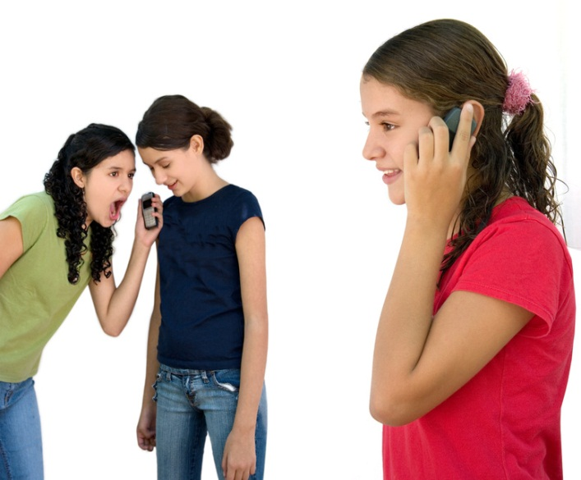
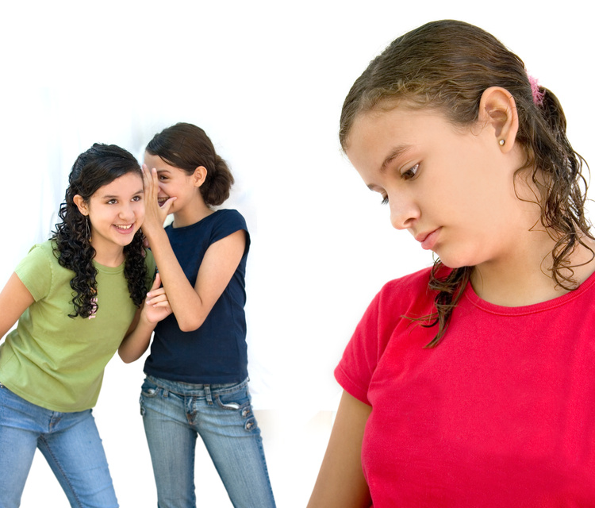
FRIENDS & CYBERBULLYING
Notes:
Just like it is not OK to bully someone in person, it is not a good idea to do it over the Internet or with phone calls, either. It can really upset the person being picked on! Ask the kids how they’d like it if someone picked on them. They probably would not like it, so it is not a good choice to do this sort of behavior over the Internet, let alone in person. It is important to inform the kids that a lot of people cyberbully because they don’t have to do the face-to-face confrontation. Therefore, kids are much more abusive online, where they cannot see the reaction of the person and possible repercussions. The Internet and technology allow the cyberbully to “hide” and do things they normally would not be brave enough to do in person.

Slide 17

FRIENDS & CYBERBULLYING
Treat Others as You Want to Be Treated
Notes:
Now would be a good time to reinforce the concept to treat others as they want to be treated! This is the Golden Rule and great advice for people of all ages!

Slide 18
WHAT SHOULD YOU DO?
TELL AN ADULT!
Notes:
Again, let the kids know that if a classmate or friend picks on them or bullies them over the Internet, they should TELL AN ADULT!. If it makes them feel sad, scared or their feelings are hurt, it is best to tell an adult who can help them.

Slide 19
THREATENING YOURSELF
TMI
Notes:
The last threat online is the kids themselves. (State to them: YOU! Yes, you! Are a threat to yourself online!) Kids may give out TMI – too much information! What is TMI? This is when they post a lot of information in a text message, email, chat session or photo that is not meant for the entire Internet to review. People of all ages are notorious for posting TMI, only later regretting their decision – when it is too late!

Slide 20

THREATENING YOURSELF
Notes:
Unfortunately, when kids post information on the Internet, it is often not private and other people can see all the information they just gave out. Sometimes people post embarrassing pictures, make rude comments or say inappropriate things – which can then be seen by many other people on the Internet! What may seem innocent at the time can later prove costly when it is visible to hundreds or thousands of people! This would be a great time to ensure the kids understand that messages are never truly private.

Slide 21
THREATENING YOURSELF
delete
delete
delete
delete
Notes:
It’s important to let the kids know that when they press the delete key, the data is never really gone. When they try to delete all of that personal information they posted, it is unlikely to ever really be deleted for good. Have the kids imagine if they posted a really silly picture of themselves that they later realized was not a good choice. In addition, when they send a text or image to a friend, they no longer control it. Even though their friend may promise not to share it, chances are the whole world will see that picture or text. We do not want kids to regret their decisions.

Slide 22
INTERNET SAFETY PLEDGE
I promise to never give out my personal information over the Internet unless my parents say I can.
Courtesy of www.staysafeonline.org
Notes:
Now it’s time to take the Internet Safety Pledge – a pledge where kids promise to be safer online. Have the kids raise their right hand and repeat after you as you read this out loud. Remind them nothing is private on the Internet. In addition, once something is shared, they can never take it back; it will always be a part of the Internet.

Slide 23
INTERNET SAFETY PLEDGE
I promise to remember that people can pretend to be someone they are not on the Internet.
Courtesy of www.staysafeonline.org
Notes:
Ensure they are keeping their right hand up and are reading and repeating after you.

Slide 24
INTERNET SAFETY PLEDGE
I promise to tell my parents if a stranger is bothering me, if my friends are hurting me or if there is something scary I do not understand.
Courtesy of www.staysafeonline.org
Notes:
Keeping your and the kids’ hands raised, here is the last sentence to read out loud. Make sure you remind kids there will be no consequences if they talk to or share with their parents.

Slide 25
LEARN MORE – FOR PARENTS
www.staysafeonline.org
www.stopbullying.gov
www.onguardonline.gov
www.rsaconference.com/safe
cyberaware.securingthehuman.org
Notes:
Here are some useful sites to help provide them, their friends and their family with tools designed to educate and raise awareness. In addition, there are links to sites offering some FREE software and services to help keep their computing devices more secure! This slide can also be printed or emailed as a reference guide for their use.

Slide 26
Computer & Internet Safety
THANK YOU & BE SAFE!
Notes:
This concludes the presentation. Thank the kids for their enthusiasm and learning more about Internet safety. Technology is a wonderful tool for kids to learn and build relationships. We want to enable that, but in a safe and secure manner. This presentation is a consensus project, designed by the community, for the community. It is supported by SANS Securing The Human. We welcome and encourage any feedback on how to improve this presentation. All feedback should be sent to community@securingthehuman.org. For more about securing families and kids, please visit http://cyberaware.securingthehuman.org.

